Slide 1
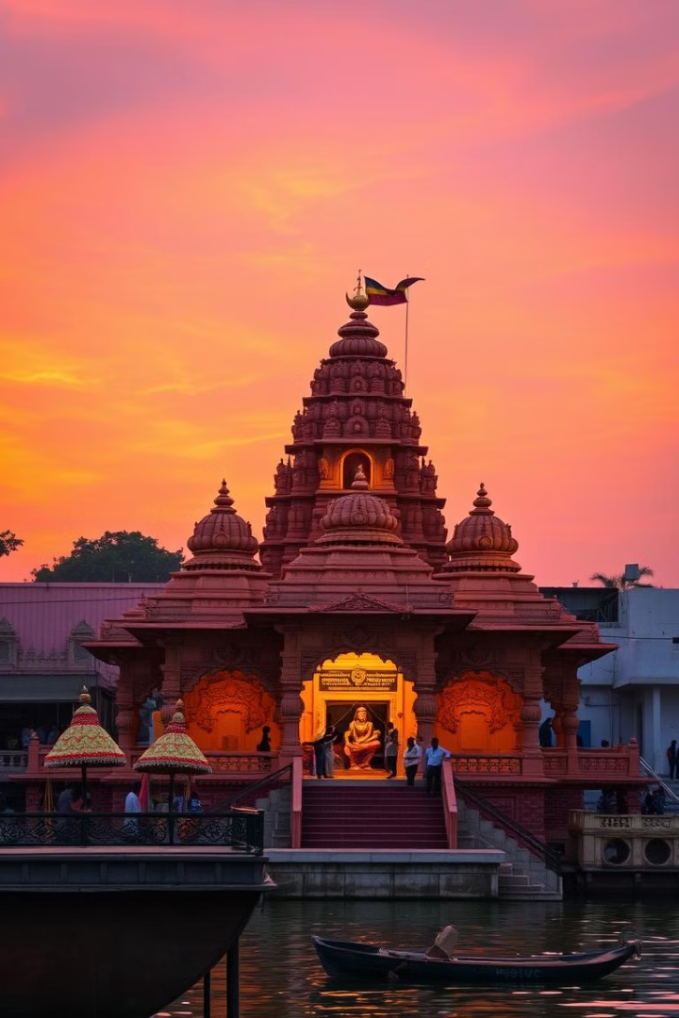

5-Day Spiritual & Cultural Trip to Vrindavan and Mathura
Embark on a transformative journey to Vrindavan and Mathura. Discover the land of Krishna, steeped in spirituality and vibrant culture.
Notes:
1

Slide 2
Introduction: The Twin Holy Cities
Vrindavan
Mathura
The playground of Krishna, known for its temples and devotion. Over 5,000 temples dedicated to Krishna and Radha.
The birthplace of Krishna, steeped in ancient history and mythology. Janmabhoomi Temple marks Krishna's birthplace.
Site of Krishna's childhood pastimes and divine love. Experience profound spirituality.
One of the oldest cities in India, with mentions in ancient texts. Experience ancient traditions.
Notes:
2

Slide 3
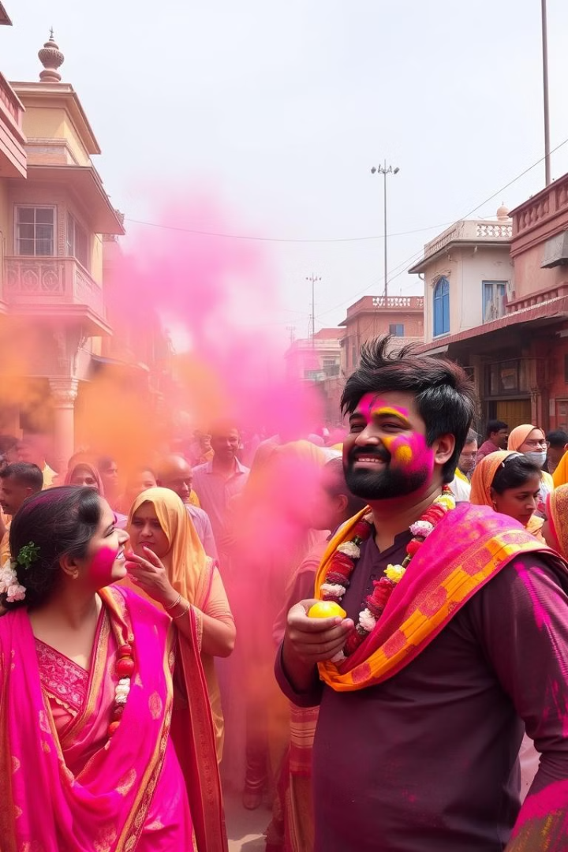




Best Time to Visit
October to March
Pleasant weather. Temperatures range from 10°C to 25°C. Comfortable for temple visits and outdoor activities.
Avoid April to June
Scorching heat. Temperatures often exceed 40°C.
Holi (March)
Celebrated with unmatched fervor and colors. Lathmar Holi in Barsana is a unique experience.
Janmashtami (August/September)
Celebrates Krishna's birth. Millions of devotees visit Mathura.
Notes:
3

Slide 4
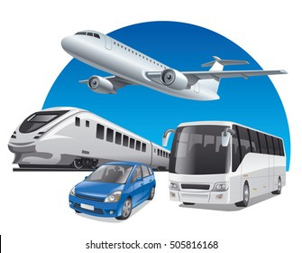




Modes of Visit/Fare
Train
Trains from Delhi to Mathura run frequently, taking 2–3 hours. Fares range from ₹50 (General),₹175 (Sleeper) ₹500 (AC), making it an affordable travel option.
Airplane
Flights from Delhi to Mathura aren't available, as Mathura has no airport. The nearest airport is in Agra, about 60 km away. Flights to Agra from Delhi take around 1 hour, with fares starting from ₹2,000.
Bus
Celebrated with unmatched fervor and colors. Lathmar Holi in Barsana is a unique experience.Buses from Delhi to Mathura take 2–3.5 hours. Fares start from ₹149 for non-AC and go up to ₹5000 for premium coaches. Major boarding points include ISBT and Anand Vihar.
Car
Traveling by car from Delhi to Mathura takes about 2.5 to 4 hours via the Yamuna Expressway or NH-19. Taxi fares start around ₹1,700 and go higher for premium options, with per km rates ranging from ₹9 to ₹16.
Notes:
3

Slide 5
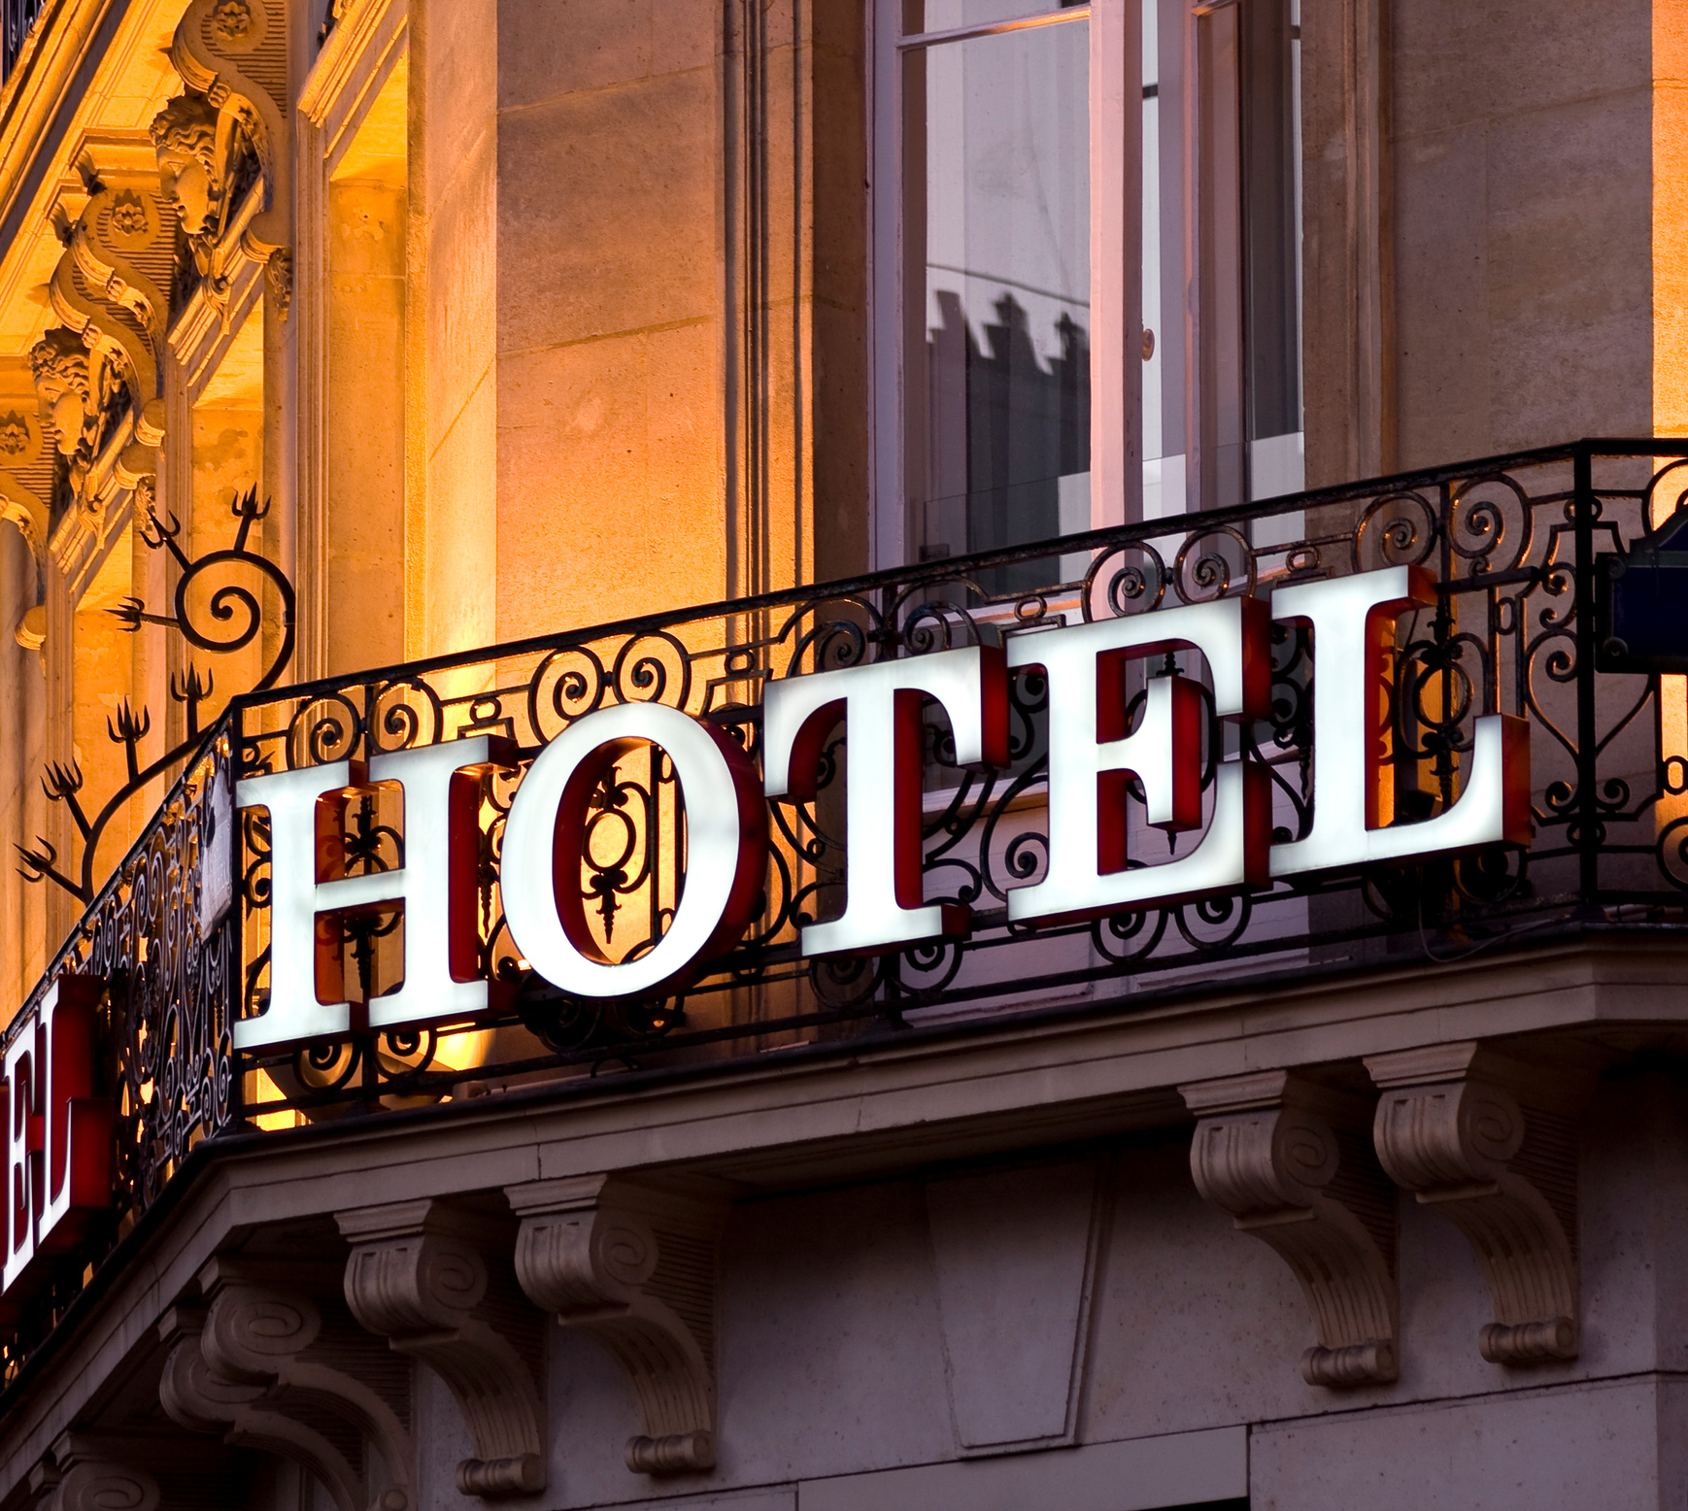
Here are additional hotels in Vrindavan and Mathura with their approximate rents per day:
Vrindavan
Hotel Krishnam: Rent starts at ₹3,767 per night for a Deluxe Double Bed room.
Hotel Shri Radha Nikunj: Rent starts at ₹3,837 per night for a Deluxe King Studio.
Hotel Kridha Residency: Rent starts at ₹2,773 per night for a Deluxe AC Room.
Best Western Vrindavan: Rent starts at ₹5,000 per night for a standard room.
Mathura
Hotel Shri Radha Nikunj: Rent starts at ₹3,837 per night for a Deluxe King Studio.
Hotel Kridha Residency: Rent starts at ₹2,773 per night for a Deluxe AC Room.
Best Western Vrindavan: Rent starts at ₹5,000 per night for a standard room.
Notes:
3

Slide 6
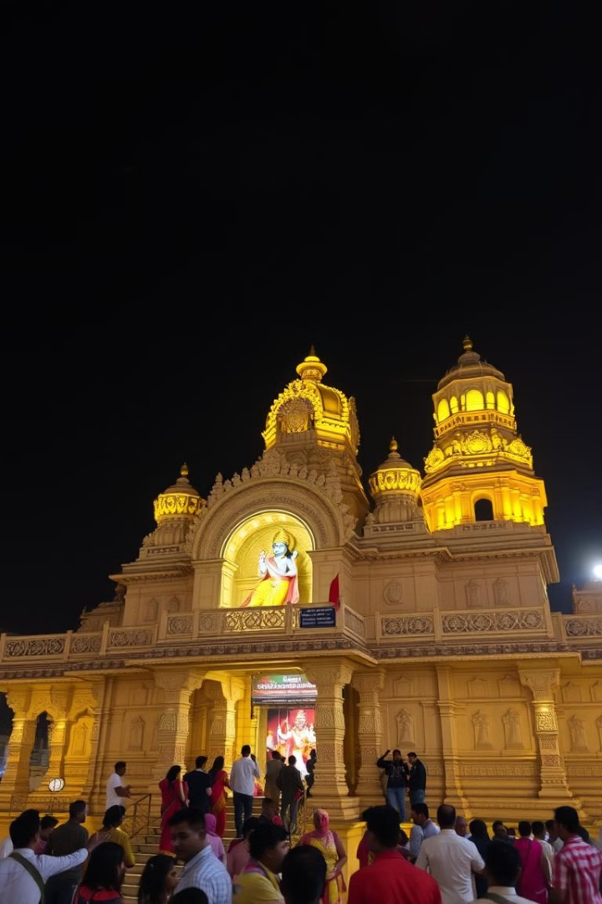



Day 1: Arrival in Mathura
Morning
Arrive at Mathura Railway Station. Transfer to your hotel.
Arrived: 7 am morning.
Afternoon
Visit Shri Krishna Janmabhoomi Temple. Explore Krishna's birthplace.
Timings: Mornings 5 am - 12 pm, Evenings 4 pm - 9:30 pm.
Evening
Attend the evening Aarti at Dwarkadhish Temple. Experience devotional songs.
Timings: 6:30–11 am, 4–7 pm
Notes:
4

Slide 7
Day 2: Mathura to Vrindavan
Morning
Afternoon
Evening
Drive from Mathura to Vrindavan.
Check-in to your hotel in Vrindavan.
Explore Vrindavan's famous temples. Visit Banke Bihari Temple.
Visit the ghats along the Yamuna River. Attend the evening Aarti at Yamuna River.
Visit ISKCON Vrindavan. A modern temple with spiritual discourses.
Then we visited Nidhivan.
Notes:
5

Slide 8
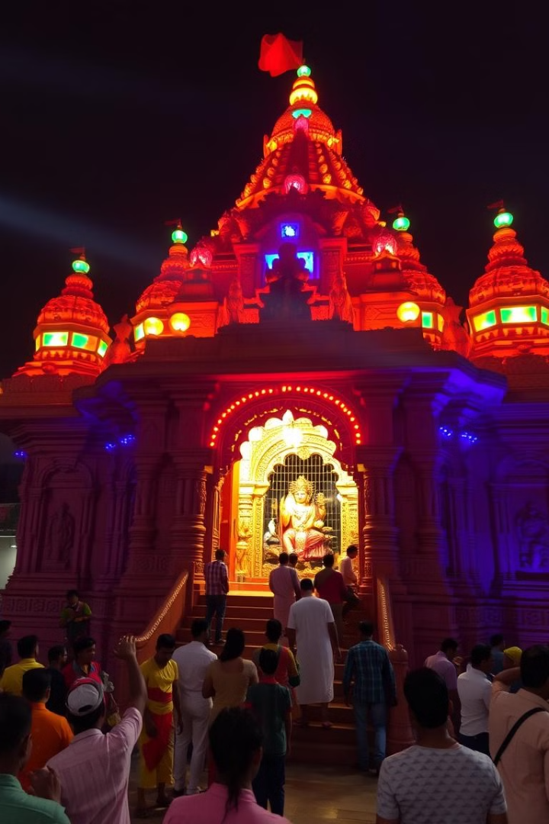
Day 3: Vrindavan Exploration
Seva Kunja
Where Krishna and Radha rested. Known for its dense groves.
Radha Raman Temple
Houses a self-manifested deity of Krishna. Participate in prayers.
Prem Mandir
Attend the evening Aarti. Witness the stunning light show.
Notes:
6

Slide 9
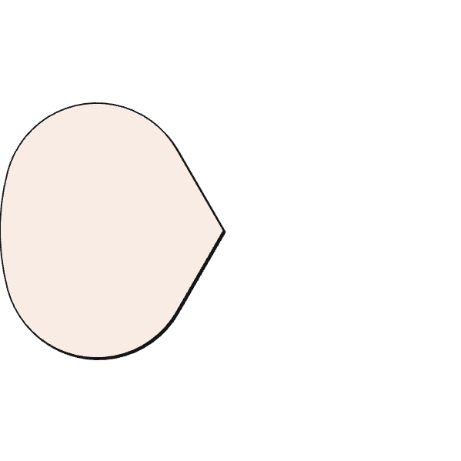
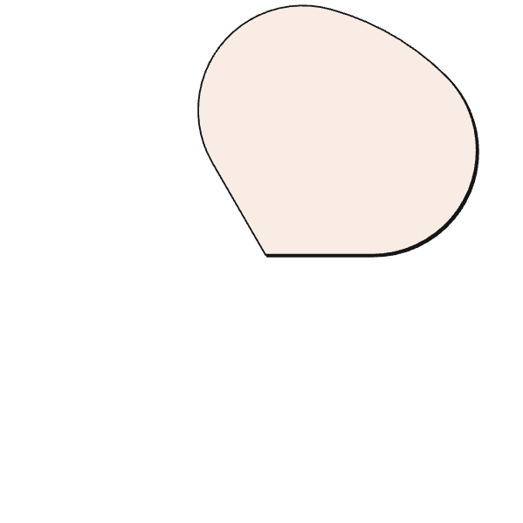
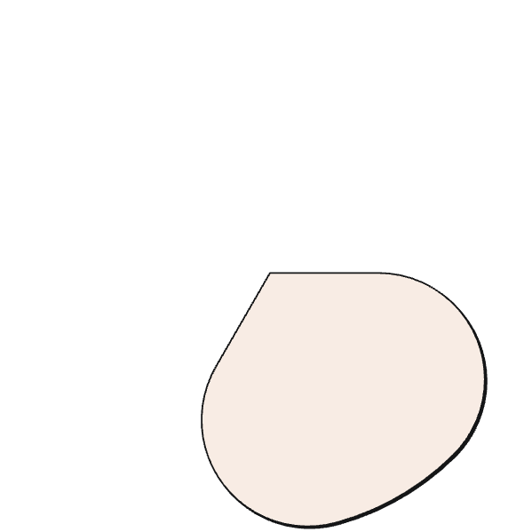
Day 4: Gokul and Govardhan
Afternoon: Govardhan
2
Perform parikrama of the sacred hill. Visit the Dan Ghati Temple.
Morning: Gokul
Visit the Chaurasi Khamba temple. Explore Raman Reti.
1
3
Evening
Return to Vrindavan/Mathura.
Notes:
7

Slide 10
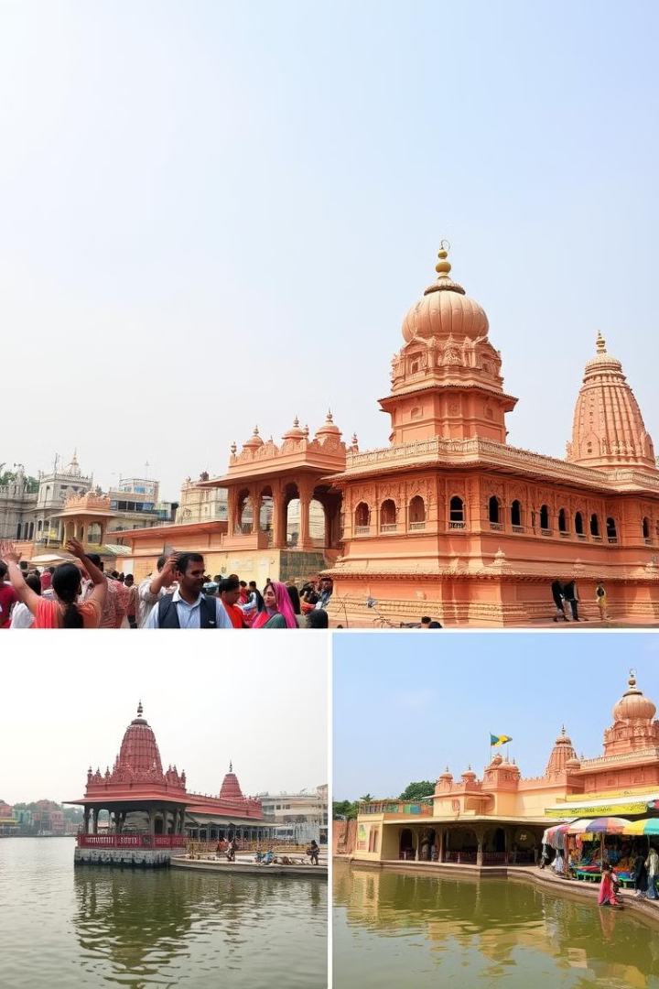



Day 5: Departure
Temples
Visit remaining temples.
Shopping
Local markets for souvenirs.
Departure
Transfer to station/airport.
Plan your spiritual journey today! with us.
Notes:
8

Slide 11
Here’s a breakdown of the estimated budget for a 5-day trip to Vrindavan and Mathura from Delhi:
Transportation
Train: ₹200–₹1,000 (one-way ticket from Delhi to Mathura).
Cab/Bus: ₹50–₹700 for local travel between Mathura and Vrindavan.
Accommodation
Budget Hotels: ₹300–₹800 per night.
Mid-range Hotels: ₹800–₹1,500 per night.
Luxury Hotels: ₹3,000–₹8,500 per night.
Food
Street Food: ₹100–₹300 per day.
Restaurants: ₹500–₹1,000 per day.
Sightseeing and Activities
Temple Visits: Free or minimal entry fees.
Local Tours: ₹500–₹1,000 per day.
Total Estimated Budget
Budget Trip: ₹5,000–₹8,000.
Mid-range Trip: ₹10,000–₹15,000.
Luxury Trip: ₹20,000–₹30,000.
Let me know if you’d like help planning the itinerary!
Notes:
8

Slide 12
SEC ASSIGNMENT
NAME :- SURAJ SINGH
ROLL NO :- 0477
COURSE :- B.A(PROG) ECO+HIS
Notes:
8

